Slide 1
Modelling Transient Data Streams
FASI Team

Slide 2
Data Stream
Data Flow in the system can be,
Continuous
Ordered, Unordered, Randomized
Changing
Rapid
Huge amount
Accumulated from multiple sources

Slide 3
Data Stream - Benefits
Supports Predictive Modeling
Anomaly Detection
Faster Decision Making
Improve Business Operations
Enhance Customer Interactions
Manage KPI’s Daily
Reduce Investment Cost

Slide 4
Data Stream – Ideal Characteristics
Low Latency
High Throughput
Persisted for Reuse
Fault Tolerant
Highly Scalable
Availability
Data Security
Off-line Support
Multi-Level / Multi-Dimensional Data Stream Support
Data Visualization Support

Slide 5
Data Stream – Real Time Industries
Telecommunication : Calling Records
Banking : Credit / Debit Card Transactions
Financial Markets : Stock Exchange
Smart Energy : Power Supply & Manufacturing
Sensor, Monitoring & Surveillance : Video Streams, RFIDs
Network Monitoring and Traffic Engineering
Web Logs and Web Page Click Streams
Security Monitoring

Slide 6
Abstract
Very large databases are required to store massive amounts of data that are continuously inserted and queried. Analyzing huge data sets and extracting valuable pattern in many applications are complex to evaluate.
Data Stream Applications have made use of statistical summaries to reason about the data using non-parametric techniques such as random sampling, histograms, sliding windows, heavy hitters, and join sizes. But with less attention has been paid to modeling stream data parametrically, despite the potential this approach has for mining the data. The challenges to do model fitting at streaming speeds are both technical likes how to continually find fast and reliable parameter estimates on high speed streams of skewed data using small space and conceptual & how to validate the goodness-of-fit and stability of the online model.
We can identify two main groups of techniques for huge data bases processing. One group refers to streaming data and applies mining techniques whereas second group attempts to solve this problem directly with efficient algorithms.
We have focused on data stream as an efficient strategy against huge data base mining instead of mining on entire data base.
The main problem in data stream processing means evolving data is more difficult to detect.
Clustering techniques can lead us to discover hidden information.

Slide 7
Case Study Model & it’s Challenges
Data Stream Model – Credit / Debit Card Transactions Flows
Real Time Challenges:
Fraud detections, Alert notifications.
Exploding Volumes of Data required to ensure validating all transactions, accuracy & maintains historical data.
Enhancing the strategy & predictions of consumer shopping habits, and in turn allow retailers to better engage with consumers with rewards.
Required auto decision making model to leverage compliance verification during transactions.

Slide 8
Use Case - Solution Proposals
Multiple Pattern Detections (MPD) & Ruleset Engines for fraud detection, alert notifications in credit card transactions.
Micro & Macro Clustering Techniques.
Random Sampling – Test Case Analysis

Slide 9
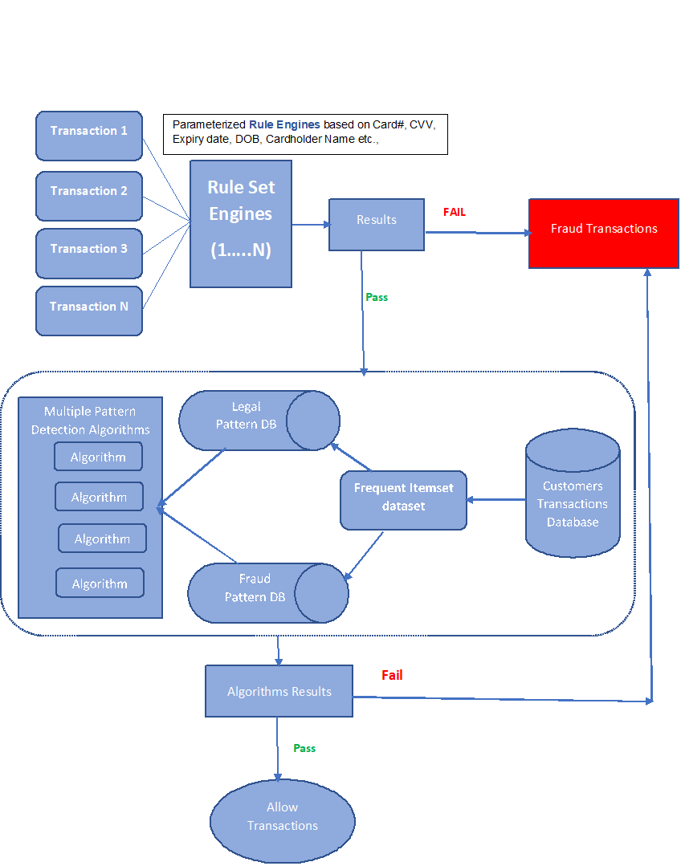
Fraud Detection – Architectural View
Types – Card Not Present (CNP), Lost, Counterfeit, Interception via communication devices, Card Not Received etc.,

Slide 10
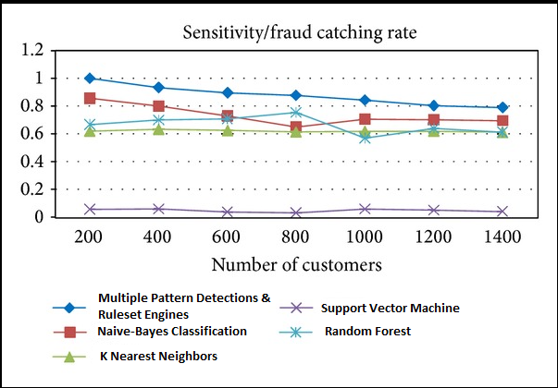
Multiple Pattern Detections (MPD) & Ruleset Engines Algorithms Results

Slide 11
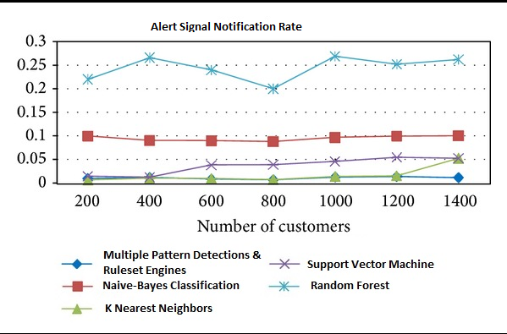
Multiple Pattern Detections (MPD) & Ruleset Engines Algorithms Results
* Measurements leads to customer dissatisfaction if suppose alert notification rate is false even in terms of legal transaction, but suspected as fraud.
MPD & Ruleset Engines prompt very less false alert notification rate in this case.

Slide 12
Random Sampling – Test Case Analysis
SAMPLE VALID CREDIT CARD NUMBERS
Credit card numbers are not random. They can be checked by a mathematical formula for validity. Each kind of credit card uses a slightly different rule.
This sample form checks credit cards for validity, so you must enter a valid credit card number. Use one of the sample numbers from this list:
Credit Card Sample Number
Visa 4111 1111 1111 XXXX
MasterCard 5500 0000 0000 XXXX
American Express 3400 0000 0000 XXX
Diner's Club 3000 0000 0000 XX
Discover 6011 0000 0000 XXXX

Slide 13
Data Stream Processing (Open Source Tools)
Apache Flink / Spark / Storm / Samza / Kafka
Amazon Kinesis

Slide 14
Chosen Data Stream Application
Business: credit card transaction flows
Present Scenario of the Application
Source Definition:-
The first step in Streams program is to establish a source for the stream. The source could be any of the following:
A single topic.
Multiple topics in a comma-separated list.
A regex that can match one or more topics.
In this case, we will use the “transaction” single topic. A Streams program runs one or more StreamThread (the number of Stream threads is user-defined) instances. Each StreamThread has an embedded Consumer and Producer that handles reading from and writing to Kafka. In addition to specifying source topic(s), you also provide Serdes for the keys and values. A Serdes instance contains the serializer and deserializer needed to convert objects to byte arrays/byte arrays to objects, respectively.

Slide 15
Present Scenario of the Application
Continued…
Step 1 : Masking Credit Card Numbers
The first goal is to mask the credit card numbers recorded in the incoming purchase records. The first processor is used to convert credit card numbers from 1234-5678-9123-2233 to xxxx-xxxx-xxxx-2233. The Stream.mapValues method performs the masking. The KStream.mapValues method returns a new KStream instance that changes the values, as specified by the given ValueMapper, as records flow through the stream. This particular KStream instance is the parent processor for any other processors you define. Our new parent processor provides the masked credit card numbers to any downstream processors with Purchase objects.

Slide 16
Present Scenario of the Application
Continued…
Step 2 : Purchase Patterns
Here’s the purchase patterns processor. It’s responsible for taking Purchase objects and converting them into Purchase Pattern objects, containing the item purchases and the zip code where the transaction took place. We’ve added a new processor that takes records from the patterns processor and writes them. Other applications can consume this information and use it to determine inventory levels, as well as purchasing trends in an area.

Slide 17
Present Scenario of the Application
Continued…
Step 3 : Rewards
the customer rewards processor responsible for transforming Purchase objects into a RewardAccumulator object containing the customer id, date, and total dollar amount of the transaction. Information for the customer rewards program.

Slide 18
Present Scenario of the Application
Continued…
Step 4 : Writing Data
This processor is responsible for writing out the entire Purchase object to another object. The consumer for this stores the results in a NoSQL store, such as MongoDB. The purchases topic is used to feed a NoSQL storage application that consumes the records as they come in.

Slide 19
Present Scenario of the Application
Source
Continued…
Masking
Rewards
Patterns
Purchases
Source
Patterns topic

Slide 20
Present Scenario of the Application
Continued…

